Slide 1
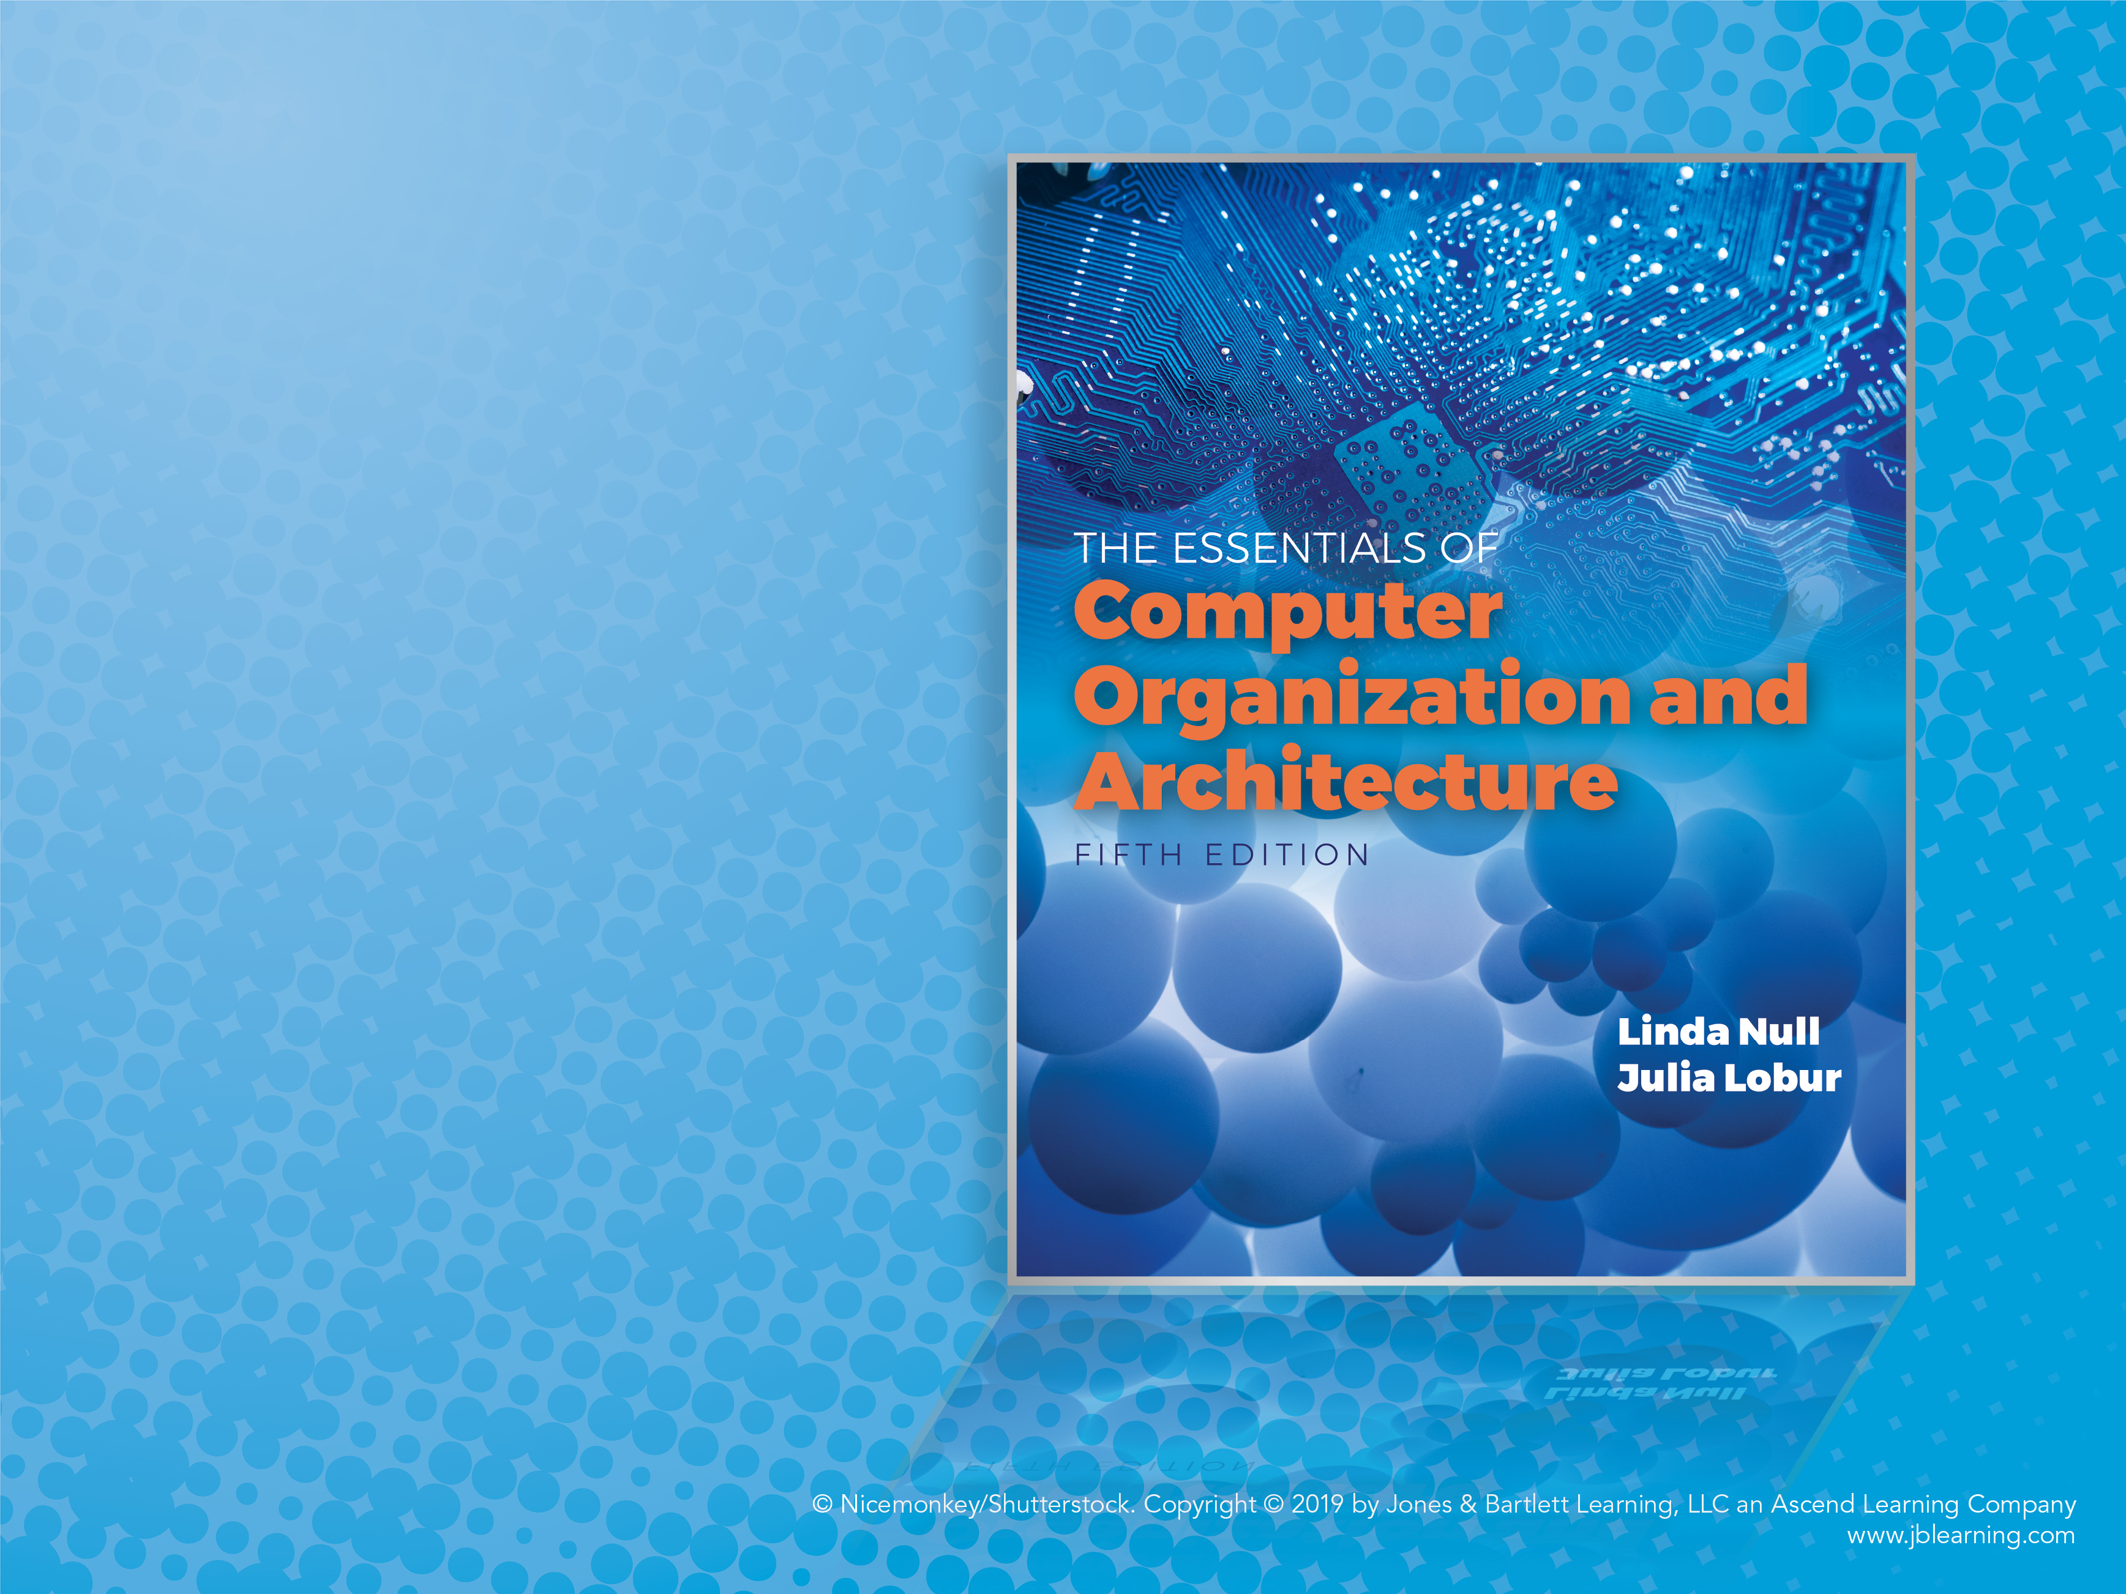
Chapter 3
Boolean Algebra and Digital Logic

Slide 2
Objectives (1)
Understand the relationship between Boolean logic and digital computer circuits.
Learn how to design simple logic circuits.
Understand how digital circuits work together to form complex computer systems.

Slide 3
Objectives (2)
Boolean Expressions
Boolean Expressions can be represented as Truth Tables
Truth Tables can be represented with Boolean Expressions
Boolean Expressions or Truth Tables can be represented with Logic Gates connected in Logic Circuits

Slide 4
3.1 Introduction (1 of 2)
In the latter part of the nineteenth century, George Boole incensed philosophers and mathematicians alike when he suggested that logical thought could be represented through mathematical equations.
How dare anyone suggest that human thought could be encapsulated and manipulated like an algebraic formula?
Computers, as we know them today, are implementations of Boole’s Laws of Thought.
John Atanasoff and Claude Shannon were among the first to see this connection.

Slide 5
3.1 Introduction (2 of 2)
In the middle of the twentieth century, computers were commonly known as “thinking machines” and “electronic brains.”
Many people were fearful of them.
Nowadays, we rarely ponder the relationship between electronic digital computers and human logic. Computers are accepted as part of our lives.
Many people, however, are still fearful of them.
In this chapter, you will learn the simplicity that constitutes the essence of the machine.

Slide 6
3.2 Boolean Algebra (1 of 17)
Boolean algebra is a mathematical system for the manipulation of variables that can have one of two values.
In formal logic, these values are “true” and “false.”
In digital systems, these values are “on” and “off,” 1 and 0, or “high” and “low.”
Boolean expressions are created by performing operations on Boolean variables.
Common Boolean operators include AND, OR, and NOT.

Slide 7
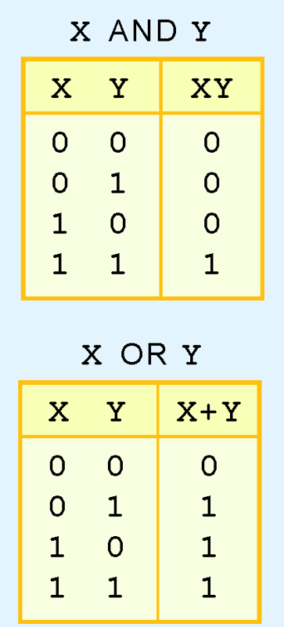
3.2 Boolean Algebra (2 of 17)
A Boolean operator can be completely described using a truth table.
The truth table for the Boolean operators AND and OR are shown at the right.
The AND operator is also known as a Boolean product. The OR operator is the Boolean sum.

Slide 8
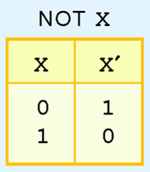
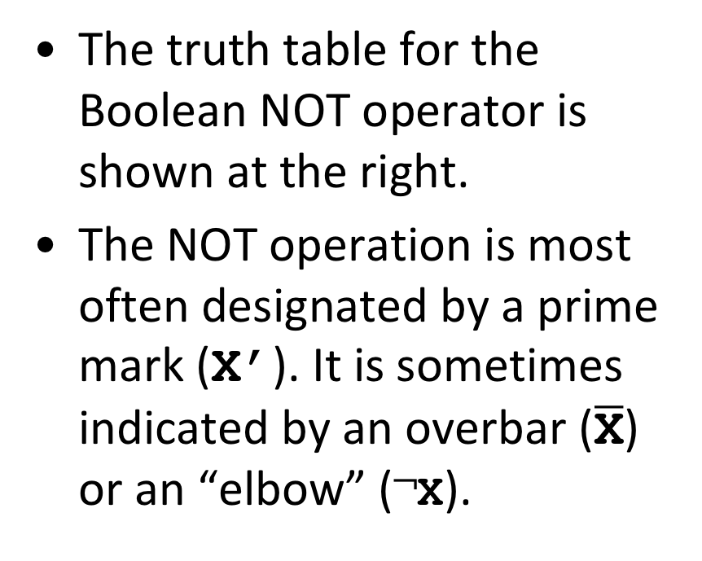
3.2 Boolean Algebra (3 of 17)
The truth table for the Boolean NOT operator is shown at the right.
The NOT operation is most often designated by a prime mark (X’). It is sometimes indicated by an overbar ($\overline{\text{X}}$) or an “elbow” (¬X).

Slide 9
3.2 Boolean Algebra (4 of 17)
A Boolean function has:
at least one Boolean variable,
at least one Boolean operator, and
at least one input from the set {0,1}.
It produces an output that is also a member of the set {0,1}.
Now you know why the binary numbering system is so handy in digital systems.

Slide 10
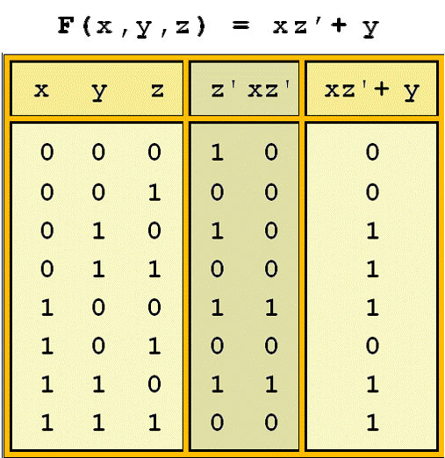
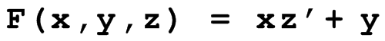
3.2 Boolean Algebra (5 of 17)
The truth table for the Boolean function:
is shown at the right.
To make evaluation of the Boolean function easier, the truth table contains extra (shaded) columns to hold evaluations of subparts of the function.

Slide 11
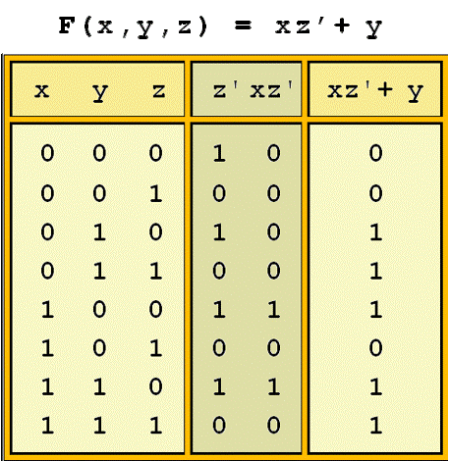
3.2 Boolean Algebra (6 of 17)
As with common arithmetic, Boolean operations have rules of precedence.
The NOT operator has highest priority, followed by AND and then OR.
This is how we chose the (shaded) function subparts in our table.

Slide 12
3.2 Boolean Algebra (7 of 17)
Digital computers contain circuits that implement Boolean functions.
The simpler that we can make a Boolean function, the smaller the circuit that will result.
Simpler circuits are cheaper to build, consume less power, and run faster than complex circuits.
With this in mind, we always want to reduce our Boolean functions to their simplest form.
There are a number of Boolean identities that help us to do this.

Slide 13
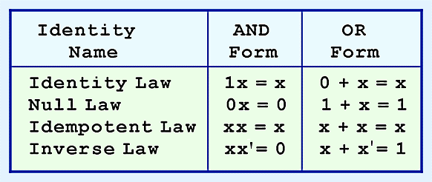
3.2 Boolean Algebra (8 of 17)
Most Boolean identities have an AND (product) form as well as an OR (sum) form. We give our identities using both forms. Our first group is rather intuitive:

Slide 14
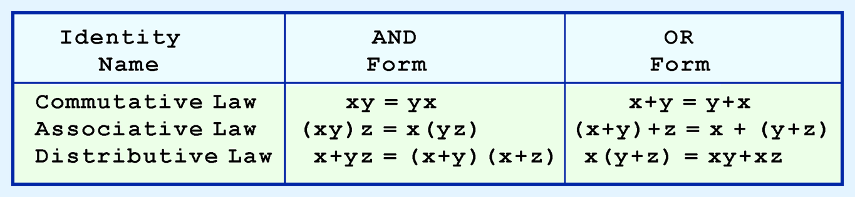
3.2 Boolean Algebra (9 of 17)
Our second group of Boolean identities should be familiar to you from your study of algebra:

Slide 15
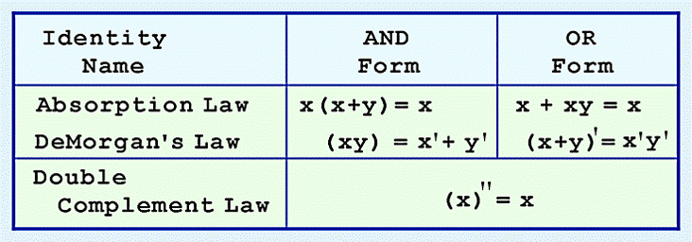
3.2 Boolean Algebra (10 of 17)
Our last group of Boolean identities are perhaps the most useful.
If you have studied set theory or formal logic, these laws are also familiar to you.
DeMorgan’s Law | (xy)’ = x’+y’ | (x+y)’ = x’y’

Slide 16
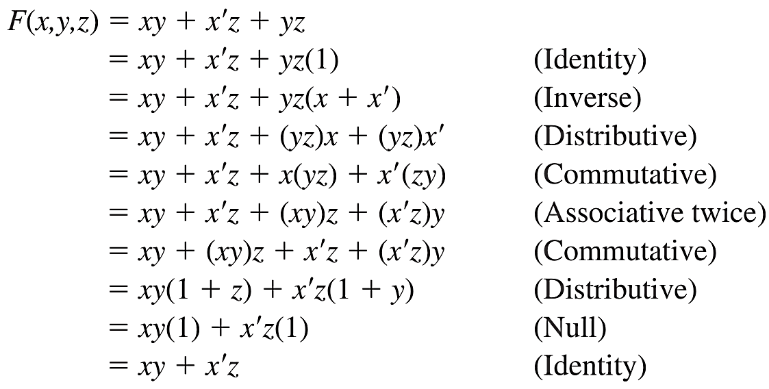
3.2 Boolean Algebra (11 of 17)
^{F(x,y,z) = xy + x′z + yz}
We can use Boolean identities to simplify:

Slide 17
3.2 Boolean Algebra (12 of 17)
Sometimes it is more economical to build a circuit using the complement of a function (and complementing its result) than it is to implement the function directly.
DeMorgan’s law provides an easy way of finding the complement of a Boolean function.
Recall DeMorgan’s law states:
(xy)’ = x’+ y’ and (x + y)’= x’y’

Slide 18
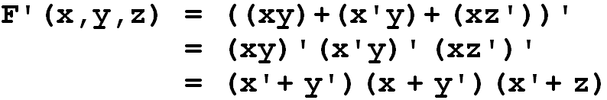
3.2 Boolean Algebra (13 of 17)
DeMorgan’s law can be extended to any number of variables.
Replace each variable by its complement and change all ANDs to ORs and all ORs to ANDs.
Thus, we find the complement of:
is:

Slide 19
3.2 Boolean Algebra (14 of 17)
Through our exercises in simplifying Boolean expressions, we see that there are numerous ways of stating the same Boolean expression.
These “synonymous” forms are logically equivalent.
Logically equivalent expressions have identical truth tables.
In order to eliminate as much confusion as possible, designers express Boolean functions in standardized or canonical form.

Slide 20
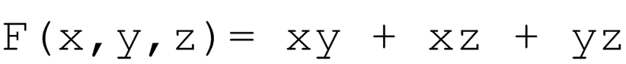
3.2 Boolean Algebra (15 of 17)
There are two canonical forms for Boolean expressions: sum-of-products and product-of-sums.
Recall the Boolean product is the AND operation and the Boolean sum is the OR operation.
In the sum-of-products form, ANDed variables are ORed together.
For example:
In the product-of-sums form, ORed variables are ANDed together.
For example:

Slide 21
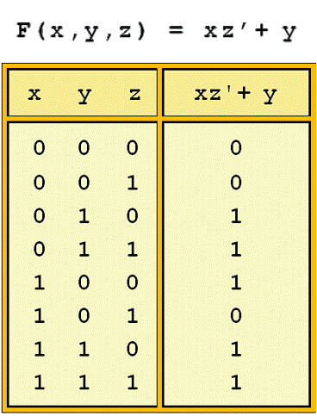
3.2 Boolean Algebra (16 of 17)
It is easy to convert a function to sum-of-products form using its truth table.
We are interested in the values of the variables that make the function true (= 1).
Using the truth table, we list the values of the variables that result in a true function value.
Each group of variables is then ORed together.

Slide 22
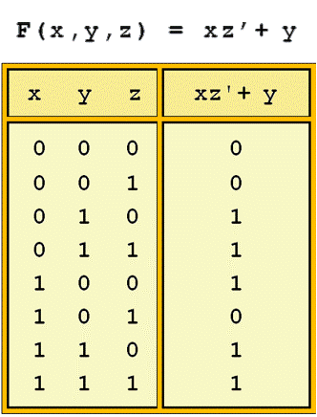
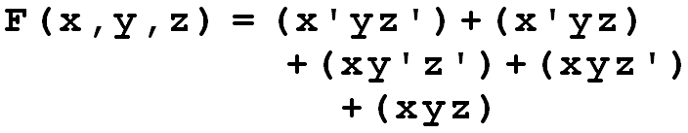
3.2 Boolean Algebra (17 of 17)
The sum-of-products form for our function is:
We note that this function is not in simplest terms. Our aim is only to rewrite our function in canonical sum-of-products form.

Slide 23
3.3 Logic Gates (1 of 6)
We have looked at Boolean functions in abstract terms.
In this section, we see that Boolean functions are implemented in digital computer circuits called gates.
A gate is an electronic device that produces a result based on two or more input values.
In reality, gates consist of one to six transistors, but digital designers think of them as a single unit.
Integrated circuits contain collections of gates suited to a particular purpose.

Slide 24
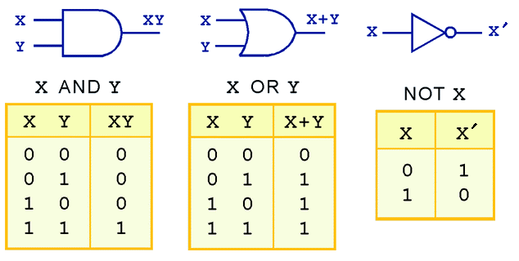
3.3 Logic Gates (2 of 6)
The three simplest gates are the AND, OR, and NOT gates.
They correspond directly to their respective Boolean operations, as you can see by their truth tables.

Slide 25
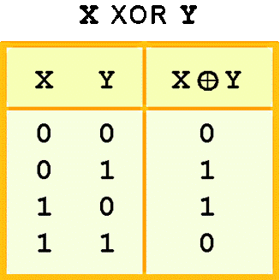
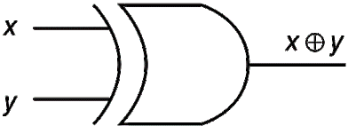
3.3 Logic Gates (3 of 6)
Another very useful gate is the exclusive OR (XOR) gate.
The output of the XOR operation is true only when the values of the inputs differ.
Note the special symbol ⊕ for the XOR operation.

Slide 26
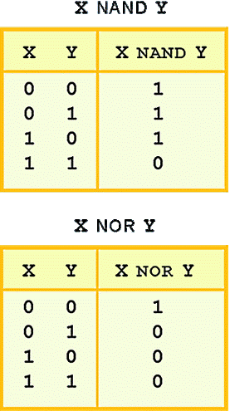
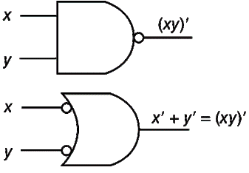
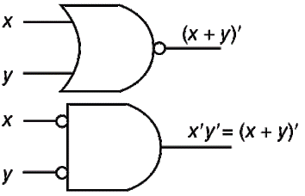
3.3 Logic Gates (4 of 6)
NAND and NOR are two very important gates. Their symbols and truth tables are shown at the right.

Slide 27
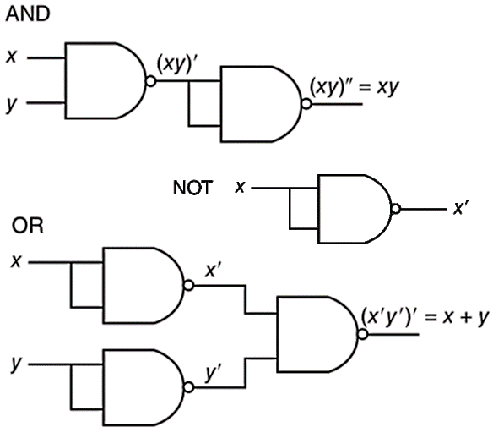
3.3 Logic Gates (5 of 6)
NAND and NOR are known as universal gates because they are inexpensive to manufacture and any Boolean function can be constructed using only NAND or only NOR gates.

Slide 28
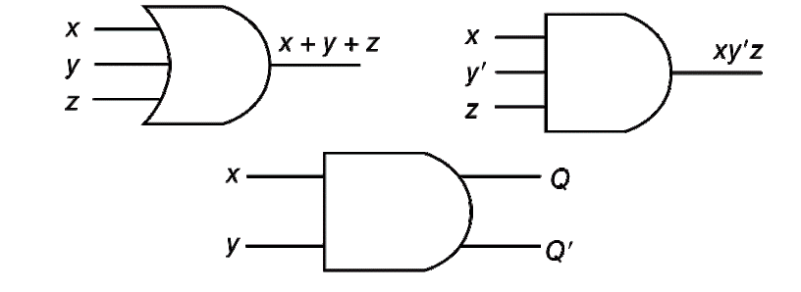
3.3 Logic Gates (6 of 6)
Gates can have multiple inputs and more than one output.
A second output can be provided for the complement of the operation.
We’ll see more of this later.

Slide 29
3.4 Karnaugh Maps
Simplification of Boolean functions leads to simpler (and usually faster) digital circuits.
Simplifying Boolean functions using identities is time-consuming and error-prone.
This special section presents an easy, systematic method for reducing Boolean expressions.

Slide 30
3.4.1 Introduction
In 1953, Maurice Karnaugh was a telecommunications engineer at Bell Labs.
While exploring the new field of digital logic and its application to the design of telephone circuits, he invented a graphical way of visualizing and then simplifying Boolean expressions.
This graphical representation, now known as a Karnaugh map, or Kmap, is named in his honor.

Slide 31
3.4.2 Description of Kmaps and Terminology (1 of 5)
A Kmap is a matrix consisting of rows and columns that represent the output values of a Boolean function.
The output values placed in each cell are derived from the minterms of a Boolean function.
A minterm is a product term that contains all of the function’s variables exactly once, either complemented or not complemented.

Slide 32
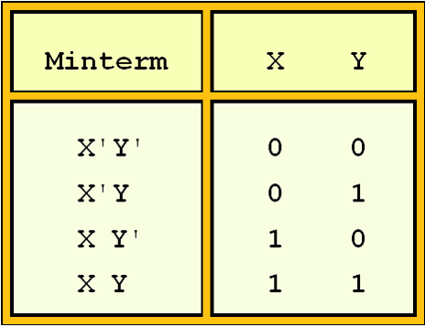
3.4.2 Description of Kmaps and Terminology (2 of 5)
For example, the minterms for a function having the inputs x and y are x’y’, x’y, xy’, and xy.
Consider the Boolean function, F(x,y)= xy + xy’
Its minterms are:

Slide 33
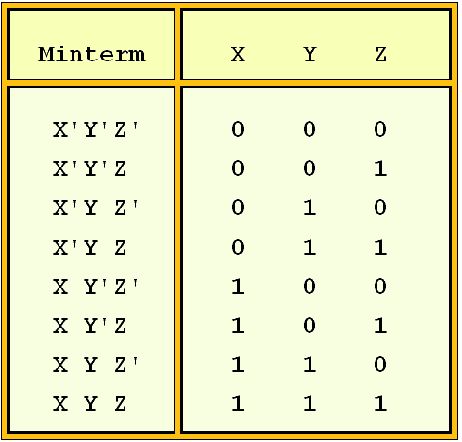
3.4.2 Description of Kmaps and Terminology (3 of 5)
Similarly, a function having three inputs, has the minterms that are shown in this diagram.

Slide 34
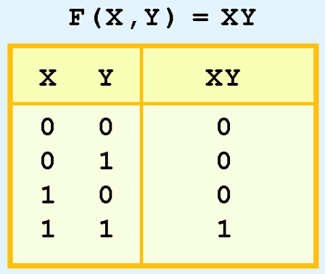
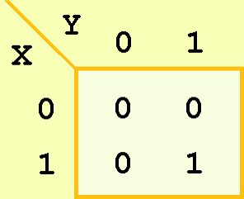
3.4.2 Description of Kmaps and Terminology (4 of 5)
A Kmap has a cell for each minterm.
This means that it has a cell for each line for the truth table of a function.
The truth table for the function F(x,y) = xy is shown at the right along with its corresponding Kmap.

Slide 35
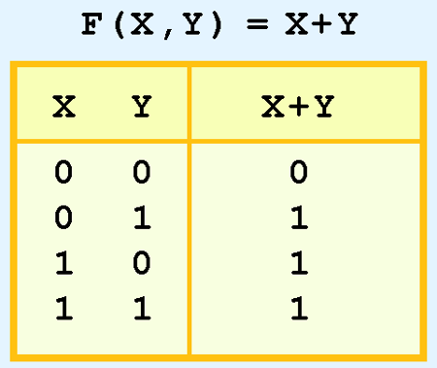
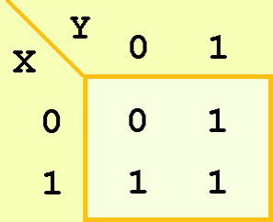
3.4.2 Description of Kmaps and Terminology (5 of 5)
As another example, we give the truth table and KMap for the function, F(x,y) = x + y at the right.
This function is equivalent to the OR of all of the minterms that have a value of 1. Thus:
^{F(x,y)= x+y = x’y+xy’+xy}

Slide 36

3.4.3 Kmap Simplification for Two Variables (1 of 3)
Of course, the minterm function that we derived from our Kmap was not in simplest terms.
That’s what we started with in this example.
We can, however, reduce our complicated expression to its simplest terms by finding adjacent 1s in the Kmap that can be collected into groups that are powers of two.
In our example, we have two such groups.
Can you find them?

Slide 37
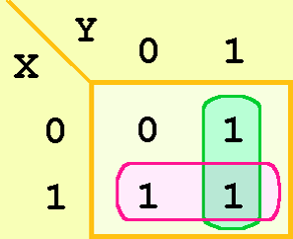
3.4.3 Kmap Simplification for Two Variables (2 of 3)
The best way of selecting two groups of 1s form our simple Kmap is shown below.
We see that both groups are powers of two and that the groups overlap.
The next slide gives guidance for selecting Kmap groups.

Slide 38
3.4.3 Kmap Simplification for Two Variables (3 of 3)
The rules of Kmap simplification are:
Groupings can contain only 1s; no 0s.
Groups can be formed only at right angles; diagonal groups are not allowed.
The number of 1s in a group must be a power of 2 – even if it contains a single 1.
The groups must be made as large as possible.
Groups can overlap and wrap around the sides of the Kmap.

Slide 39
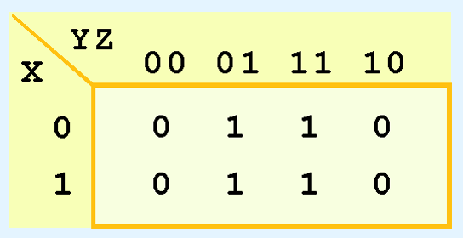
3.4.4 Kmap Simplification for Three Variables (3 of 7)
Consider the function:
Its Kmap is given below.
What is the largest group of 1s that is a power of 2?
F(X,Y,Z)= X’Y’Z + X’YZ + XY’Z + XYZ

Slide 40
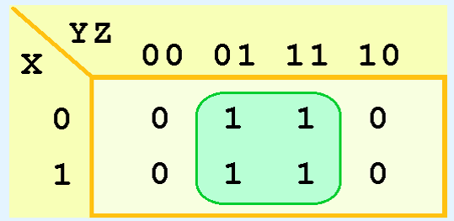
3.4.4 Kmap Simplification for Three Variables (4 of 7)
This grouping tells us that changes in the variables x and y have no influence upon the value of the function: They are irrelevant.
This means that the function,
reduces to F(x) = z.
F(X,Y,Z)= X’Y’Z + X’YZ + XY’Z + XYZ
You could verify this reduction with identities or a truth table.

Slide 41
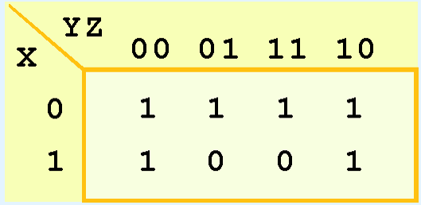
3.4.4 Kmap Simplification for Three Variables (5 of 7)
Now for a more complicated Kmap. Consider the function:
Its Kmap is shown below. There are (only) two groupings of 1s.
Can you find them?
^{F(X,Y,Z)= X’Y’Z’+ X’Y’Z + X’YZ}
^{+ X’YZ’+ XY’Z’+ XYZ’}

Slide 42
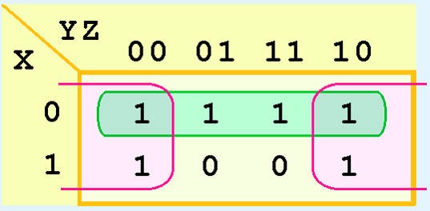
3.4.4 Kmap Simplification for Three Variables (6 of 7)
In this Kmap, we see an example of a group that wraps around the sides of a Kmap.
This group tells us that the values of x and y are not relevant to the term of the function that is encompassed by the group.
What does this tell us about this term of the function?
What about the green group in the top row?

Slide 43

3.4.4 Kmap Simplification for Three Variables (7 of 7)
The green group in the top row tells us that only the value of x is significant in that group.
We see that it is complemented in that row, so the other term of the reduced function is X’
Our reduced function is F(X,Y,Z)= X’+ Z’
Recall that we had six minterms in our original function!

Slide 44
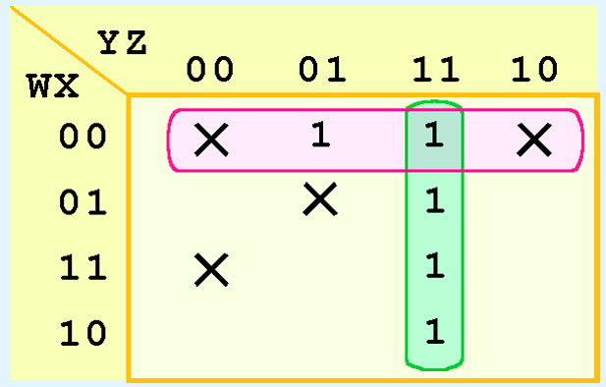
3.4.6 Don’t Care Conditions (3 of 5)
In one grouping in the Kmap below, we have the function:
^{F(W,X,Y,Z)= W’Y’+ YZ}

Slide 45
3.4.7 Summary (1 of 2)
Kmaps provide an easy graphical method of simplifying Boolean expressions.
A Kmap is a matrix consisting of the outputs of the minterms of a Boolean function.
In this section, we have discussed 2-, 3-, and 4-input Kmaps. This method can be extended to any number of inputs through the use of multiple tables.

Slide 46
3.4.7 Summary (2 of 2)
Recapping the rules of Kmap simplification:
Groupings can contain only 1s; no 0s.
Groups can be formed only at right angles; diagonal groups are not allowed.
The number of 1s in a group must be a power of 2 – even if it contains a single 1.
The groups must be made as large as possible.
Groups can overlap and wrap around the sides of the Kmap.
Use don’t care conditions when you can.

